Slide 1

Sustain Strategy
Supplier Introduction
https://www.morrisons-corporate.com/morrisons-sustainability/sustainability/

Slide 2

Introduction to Sustain
This is a brief introduction to the Sustainability programme in Morrisons known as Sustain.
Sustain applies to all aspects of our business, including our supply chain, and it is critical our suppliers understand what we are working on - as well as how we can work together on many of the actions.
This introduction is designed to give you a simple insight into the structure of the Sustain programme within Morrisons, how it applies to you, and highlight the areas we need to work together on.
Further details, including our targets and performance, can be found on our corporate website here or by contacting the sustainability team at sustainability@morrisonsplc.co.uk

Slide 3





Our 5 Chapters
Our Sustain structure is centered around five chapters, each of which have five goals. Internally, we have nine workstreams delivering these goals.
Chapter 1: Reducing our energy use and impact on the climate
Chapter 2: Reducing packaging, Waste & Water
Chapter 3: Sustainable and responsible sourcing
Chapter 4: Supporting healthy & sustainable diets
Chapter 5: Building an inclusive culture and delivering social impact

Slide 4
5 Goals
The 5 goals for each chapter have been selected specifically to reflect the breadth of the challenges our food system faces and achieve the most effective change within our scope of influence.
We are committed to achieve Net Zero greenhouse gas emissions by 2050.
We will reduce our operational Scope 1 and 2 emissions by 80.6% by 2035 from a 2019 baseline.
We will reduce our Scope 3 (non FLAG) emissions by 40% by 2035 from a 2019 baseline.
We will reduce our agricultural emissions (FLAG Scope 3 emissions) by 48.5% by 2035.
We will decarbonise our transport and logistics operations in line with our SBTI climate targets.
50% absolute reduction in own brand primary plastic packaging from a 2017 baseline
50% reduction in food waste in store by 2030 from a 2016 baseline, and significantly reduce cost of food waste
Reduce our total packaging weight by a minimum of 20%
Actively contribute to the WRAP goal that 50% of UK fresh food will be sourced from areas with sustainable water management by 2030
By 2030, substantially increase water-use efficiency across the business in line with SDG 6

Slide 5
Our 5 Goals continued
Zero deforestation and land conversion by 2025, with 100% certified sustainable supply chains in key commodities; palm oil, soya, and timber-derived products
100% of fish and seafood will come from third-party verified responsible sources where viable
Working with British farmers we know and trust, we will deliver the 5 Domains for animal welfare
Our Sustain program supports the regeneration and protection of nature
Everyone who helps make our products is treated with dignity and respect, in safe and fair workplaces
Support our customers to make positive nutrition choices and eat according to the recommendations of the Eatwell Guide
At least 75% of our own brand products and >65% of total business will be non HFSS by 2027
Support removal of unnecessary additives and cleaner ingredient declarations
Support the diets of our most vulnerable customers
Continue to develop healthy, affordable and accessible food and services for all
Continue to foster a culture where everyone is welcome and celebrated
Raise £15m for our charity partner Marie Curie by 2027, while also supporting charity appeals which resonate with our customers and colleagues
Tackle food poverty through redistribution initiatives and facilitation of customer donations
Support good causes in the communities we serve with £2 million in donations from the Morrisons Foundation
Engage with our stakeholders on sustainability and achieve a top half performance in our chosen customer metric by 2027

Slide 6
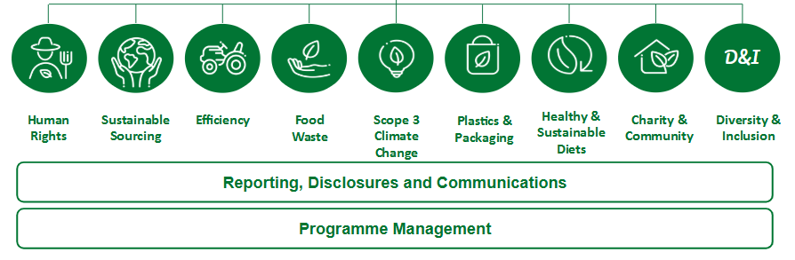
Our 9 Workstreams
Our Sustain programme is segmentented into nine workstreams, each with a director sponsor, and managed with a 1 and 3 year plan. Sustain is underpinned and supported by reporting, communications and programme management.

Slide 7
Supplier actions
Brief your commercial, supply chain and technical teams on this plan
Understand and ensure you meet our ethical trade policy
Register with SEDEX, complete the risk assessment and link to Morrisons
Report carbon, water and waste data via Manufacture 2030 annually
Support us with suggestions and innovation to achieve our goals for zero deforestation, reducing plastic and packaging, animal welfare, health, seafood and human rights.
Where requested, engage in the Now, Soon, Later plan process. (30 biggest suppliers in 2025)
Where relevant, understand the Supplier scorecard including sustainability within Produce
Share any great sustainability stories or achievements we have together

